Slide 1
IMMANUEL KANT’S THEORETICAL MORAL ARGUMENT FOR THE EXISTENCE OF GOD
(AS RECONSTRUCTED BY ROBERT MERRIHEW ADAMS)

Slide 2
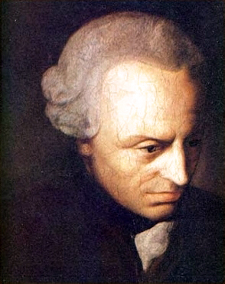
IMMANUEL KANT (1724-1804)

Slide 3
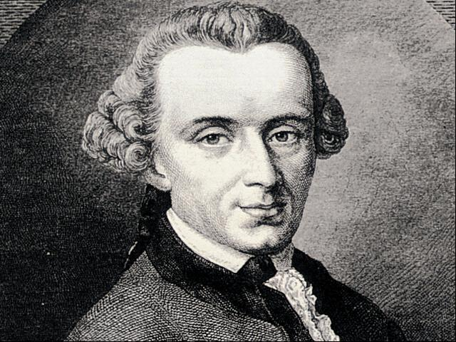

Slide 4
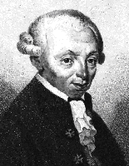

Slide 5
KANT’S THEORETICAL MORAL ARGUMENT FOR THE EXISTENCE OF GOD
We ought (morally) to promote the realization of the highest good.
(B) What we ought to do must be possible for us to do.

Slide 6
(C) It is not possible for us to promote the realization of the highest good unless there exists a God who makes the realization possible.
 (D) There exists such a God.

Slide 7
OBJECTIONS (OFFERED BY ADAMS)
The ethical correctness of Kant’s conception of the highest good is ethically correct.
Perhaps there is some non-theistic basis for the perfect proportionment of happiness to virtue.
EXPLANATION: These are both objections to premise (C ).
(Homework: Is the argument deductively valid?)

Slide 8
A STRONG OBJECTION TO PREMISE (A) (ALSO OFFERED BY ADAMS)
A STRONG OBJECTION TO PREMISE (A) (ALSO OFFERED
IN ANY REASONABLE MORALITY WE WILL BE OBLIGATED TO PROMOTE ONLY THE BEST ATTAINABLE APPROXIMATION OF THE HIGHEST GOOD.

Slide 9
(TENTATIVE) EVALUATION OF THE ARGUMENT
ADAMS’ OBJECTIONS TO THIS RECONSTRUCTION OF KANT’S ARGUMENT SEEM TO BE WELL-TAKEN. WE MAY WELL AGREE WITH HIM THAT “KANT’S THEORETICAL MORAL ARGUMENT FOR THEISM … [IS]… NOT … VERY PROMISING…”.

Slide 10
HOMEWORK
(1) EVALUATE ADAMS’ RECONSTRUCTION OF KANT’S PRACTICAL ARGUMENT FOR THEISTIC BELIEF (p. 20).
(2) FORMULATE FULLY AND EVALUATE ADAMS’ MORAL ARGUMENT FOR PROPOSITION (K) (p. 25).

Slide 11
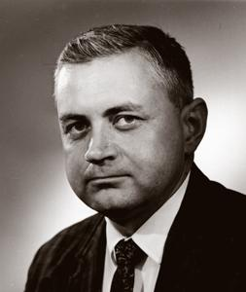
RELIGION AND THE QUEERNESS OF MORALITY
GEORGE I. MAVRODES
PROFESSOR EMERITUS, UNIVERSITY OF MICHIGAN

Slide 12
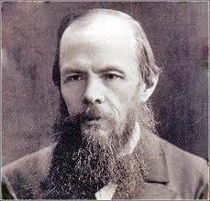
FYODOR DOSTOEVSKY (1821-1881)

Slide 13
DOSTOEVSKY’S PRINCIPLE
“IF THERE IS NO GOD, THEN EVERYTHING IS PERMITTED.”
THE BROTHERS KARAMAZOV

Slide 14
HUME’S PRINCIPLE ABOUT “OUGHT” AND “IS”
(HP) IT IS IMPOSSIBLE TO VALIDLY DEDUCE AN “OUGHT -STATEMENT” FROM “IS- STATEMENTS.”
ANOTHER VERSION:
(HP*) NO ARGUMENT WITH PURELY FACTUAL-STATEMENTS AS PREMISES AND A VALUE- STATEMENT AS CONCLUSION CAN BE DEDUCTIVELY VALID

Slide 15
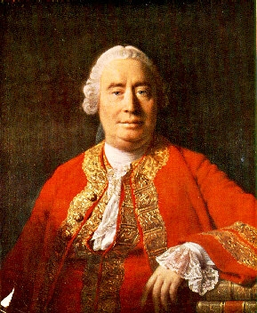
DAVID HUME (1711-1776)

